Slide 1
Annual income Classification
whether a person makes over 50K a year
Hassan Teymoori : 1947458
Big data computing 2020/21

Slide 2
Table of Contents
01
02
03
04
05
06
Classification Task
Application
Dataset
What is the Classification task in this project
Possible application in the real world.
Dataset description and structure
Data Exploration
Learning Pipeline
Conclusion
Explain the observations and challenges
Feature analysis and methods
What is the outcome and future work

Slide 3
01
The Classification Task
What is the task?

Slide 4
The Classification Task
The classification task is, given a new person information, to predict an individual s’ earning is more or less than 50,000 $ USD.
?
50,000 $

Slide 5



02
Possible Applications
What would be the possible app?

Slide 6
Possible application
The recent coronavirus outbreak has seen a tremendous amount of people who signed up for the stimulus checks of $1200 in America after losing their jobs.
Notes:
The recent coronavirus outbreak has seen a tremendous amount of people who signed up for the stimulus checks of $1200 in America after losing their jobs. One of the requisites for the recipients is to have their annual incomes less than $75,000, which is all accessible through their annual tax report. (Singletary, 2020) Nonetheless, there is a staggering amount of people who have not done their taxes. Understanding the potential annual income of unfiled taxes individuals can help the government to make strategic steps in taking care of them and ensuring the size of their bank reserve. Thus, the government would benefit tremendously from a machine learning model that can help predict an individual’s income base on their demographic features.

Slide 7
Possible application
The recent coronavirus outbreak has seen a tremendous amount of people who signed up for the stimulus checks of $1200 in America after losing their jobs.
Requirement: their annual incomes < $75,000

Slide 8
Possible application
The recent coronavirus outbreak has seen a tremendous amount of people who signed up for the stimulus checks of $1200 in America after losing their jobs.
Requirement: their annual incomes < $75,000
Problem: a big amount of people who have not done their taxes.

Slide 9
Possible application
The recent coronavirus outbreak has seen a tremendous amount of people who signed up for the stimulus checks of $1200 in America after losing their jobs.
Requirement: their annual incomes < $75,000
Problem: a big amount of people who have not done their taxes.
Understanding the potential annual income of unfiled taxes individuals for government to make strategic steps in taking care of them.

Slide 10
Possible application
The recent coronavirus outbreak has seen a tremendous amount of people who signed up for the stimulus checks of $1200 in America after losing their jobs.
Requirement: their annual incomes < $75,000
Problem: a big amount of people who have not done their taxes.
Understanding the potential annual income of unfiled taxes individuals for government to make strategic steps in taking care of them.
The government would benefit from a ML model that can help predict an individual’s income base on their demographic features.

Slide 11
03
The Dataset
Structure of the dataset

Slide 12
The Dataset
The version in the Kaggle website contains of 32K rows

Slide 13
The Dataset
The version in the Kaggle website contains of 32K rows
The version in the UCI website contains of Almost 50K rows.

Slide 14
The Dataset
The version in the Kaggle website contains of 32K rows
The version in the UCI website contains of Almost 50K rows.
I assumed the version in the Kaggle is only the training dataset and the one in the UCI is the combination of the training set and test set.

Slide 15
The Dataset
The version in the Kaggle website contains of 32K rows
The version in the UCI website contains of Almost 50K rows.
I assumed the version in the Kaggle is only the training dataset and the one in the UCI is the combination of the training set and test set.
I have used the second one.

Slide 16
The Dataset
Contains 48,842 records.
The dataset has 15 columns (one is the target variable).
There are 8 categorical columns
Target column is also categorical
There are 6 numerical columns

Slide 17
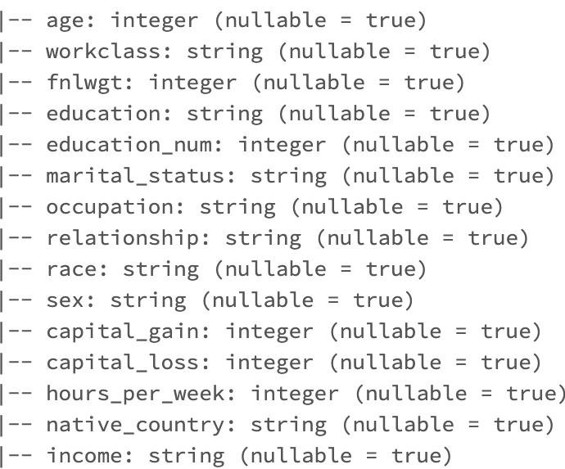
The Dataset
Contains 48,842 records.
The dataset has 15 columns (one is the target variable).
There are 8 categorical columns
Target column is also categorical
There are 6 numerical columns

Slide 18
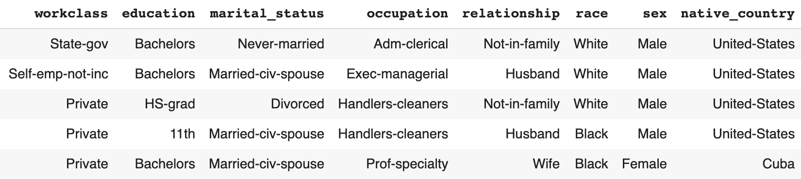
The Dataset
Categorical Features

Slide 19
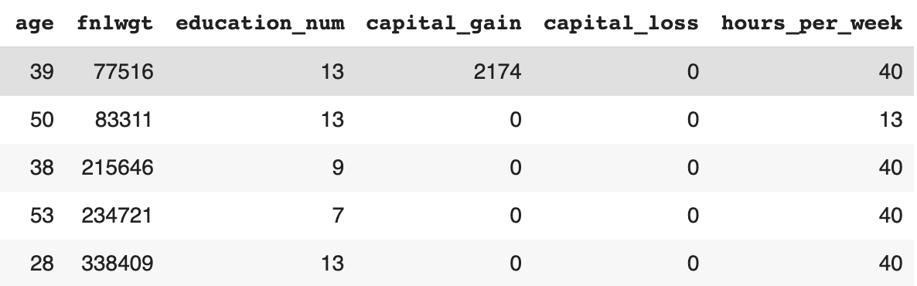
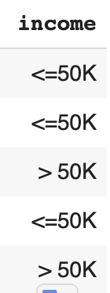
The Dataset
Numerical Features
Target Variable

Slide 20
04
Data Exploration
Observations and challenges

Slide 21
Countries
United State
Most of the data are take from US
Mexico
Rest of world

Slide 22
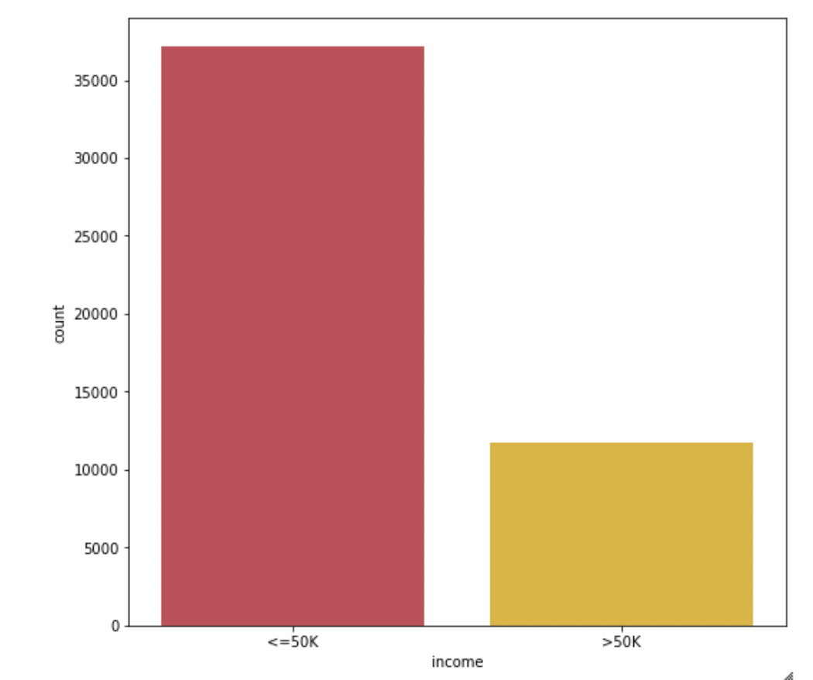
Data Exploration
Unbalanced Dataset
my dataset is not highly unbalanced but making it to be balanced is a good way to make sure the outcome is reliable.
with and without balancing approaches and compared the result

Slide 23
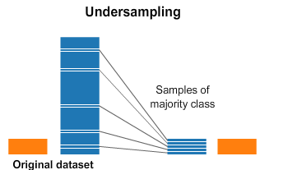
Data Exploration
50%
Unbalanced Dataset
The Solutions?
Source of picture

Slide 24
Data Exploration
50%
Unbalanced Dataset
The Solutions?
Or
Over-sampling
Source of picture

Slide 25
Data Exploration
50%
Unbalanced Dataset
The Solutions?
Or
Over-sampling
Or
Give weight to samples
Source of picture

Slide 26
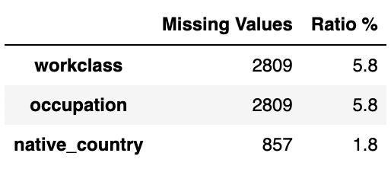
Data Exploration
Missing Values
Missing Values encoded as a question mark in 3 categorical columns

Slide 27
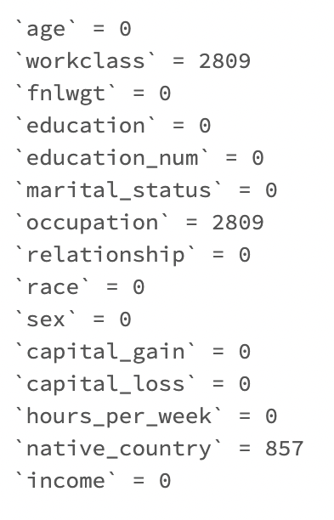
Data Exploration
Missing Values

Slide 28
Data Exploration
Missing Values
Remove the missing values
The Solutions?
Replace Them

Slide 29
Data Exploration: Summary
Missing Data
balanced dataset.
Categorical features needed to be encoded;
Different scales of feature values;
Several outliers on the age variable;
Clear Skewed problem on the age, fnlwgt variable;

Slide 30
05
Learning Pipeline
Methods and results

Slide 31
Learning Pipeline
Another important note is that: - I do not have testing set.
The first step is to tackle with the data exploration observations.

Slide 32
Learning Pipeline
Balancing the Dataset.
Down-sampling (under sampling)
Over-sampling
Give weight to samples

Slide 33
Learning Pipeline
Balancing the Dataset.
Down-sampling (under sampling)
Over-sampling
Give weight to samples
Providing The test set
Split The dataset into two portions
Training set 80%
Test set 20%

Slide 34
Learning Pipeline
Categorical Features
Transform to numerical features:
String indexer
One-Hot-Encoder
Vector Assembler

Slide 35
Learning Pipeline
Method that I used
Logistic Regression
Decision Tree
Random Forest
SVM
Gradient Boosted Decision Tree

Slide 36
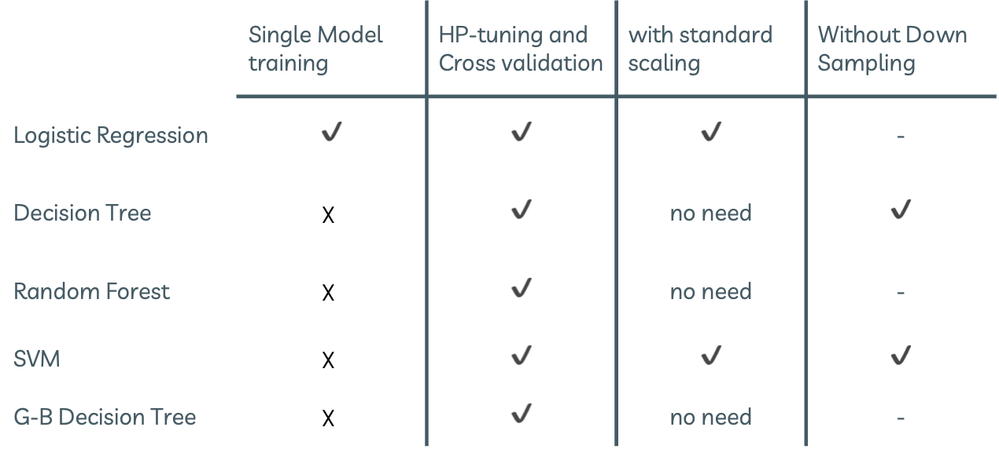
Learning Pipeline: Methods
 | Single Model training | HP-tuning and Cross validation | with standard scaling | Without Down Sampling
Logistic Regression | ✔️ | ✔️ | ✔️ | -
Decision Tree | $$☓$$ | ✔️ | no need | ✔️
Random Forest | $$☓$$ | ✔️ | no need | -
SVM | $$☓$$ | ✔️ | ✔️ | ✔️
G-B Decision Tree | $$☓$$ | ✔️ | no need | -

Slide 37
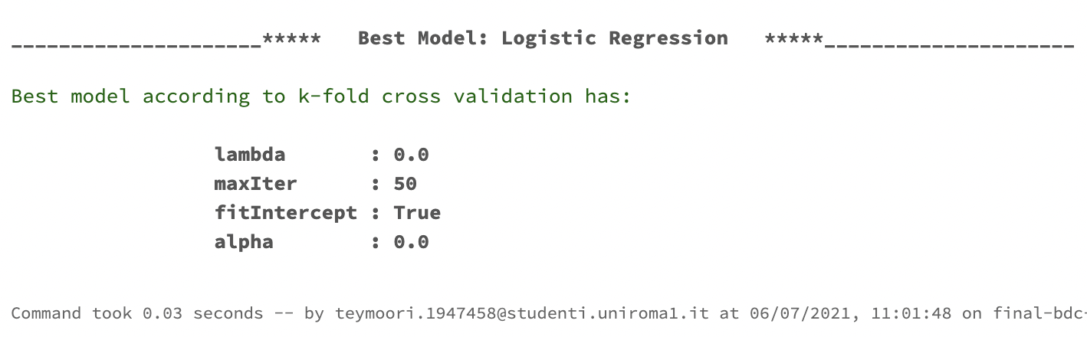
Learning Pipeline: Logistic Regression

Slide 38
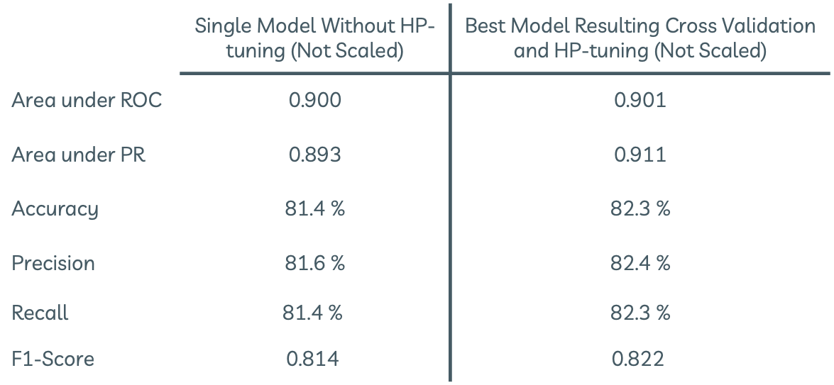
Learning Pipeline: Logistic Regression
 | Single Model Without HP-tuning (Not Scaled) | Best Model Resulting Cross Validation and HP-tuning (Not Scaled)
Area under ROC | 0.900 | 0.901
Area under PR | 0.893 | 0.911
Accuracy | 81.4 % | 82.3 %
Precision | 81.6 % | 82.4 %
Recall | $$\text{8}\text{1}\text{.}\text{4}\text{ \%}$$ | 82.3 %
F1-Score | $$\text{0.}\text{8}\text{14}$$ | $$\text{0.}\text{822}$$

Slide 39
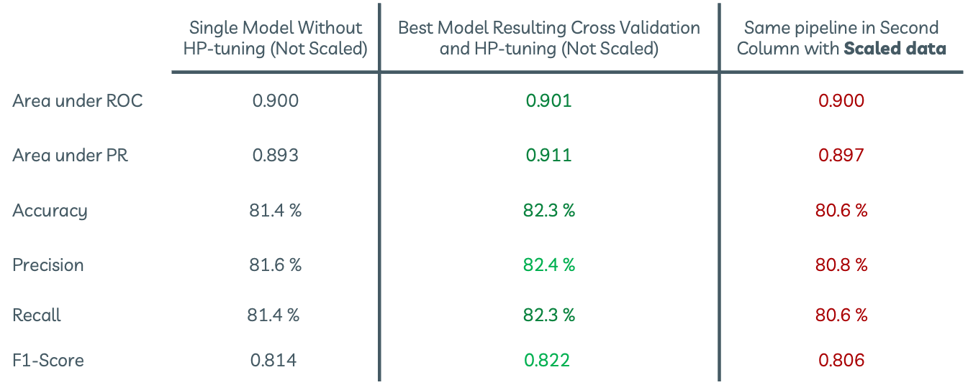
Learning Pipeline: Logistic Regression
 | Single Model Without HP-tuning (Not Scaled) | Best Model Resulting Cross Validation and HP-tuning (Not Scaled) | Same pipeline in Second Column with Scaled data
Area under ROC | 0.900 | 0.901 | 0.900
Area under PR | 0.893 | 0.911 | 0.897
Accuracy | 81.4 % | 82.3 % | 80.6 %
Precision | 81.6 % | 82.4 % | 80.8 %
Recall | $$\text{8}\text{1}\text{.}\text{4}\text{ \%}$$ | 82.3 % | 80.6 %
F1-Score | $$\text{0.}\text{8}\text{14}$$ | $$\text{0.822}$$ | 0.806

Slide 40
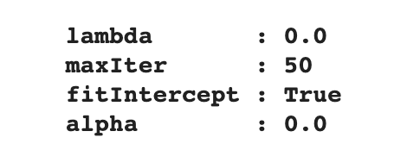
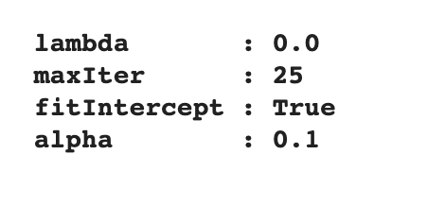
Learning Pipeline: Logistic Regression
I expected by applying the scaling the result would be better.
Why Not?
Without Scaling
With Scaling
Accuracy: 82.3 %
Accuracy: 80.6 %
My bad: I should have tried other hyper-parameters: (MaxIter > 25)

Slide 41
Learning Pipeline: Logistic Regression
Check generalization (overfitting)
Best Model
Training Set
Test Set
areaUnderROC:
0.907
areaUnderROC:
0.901
My model is not overfitted and it would be able to generalize well to the new data as like my test set

Slide 42
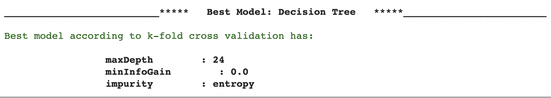
Learning Pipeline: Decision Tree

Slide 43
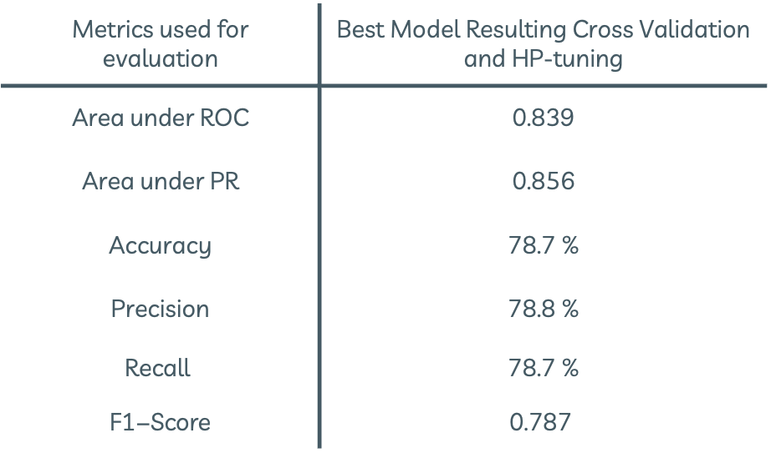
Learning Pipeline: Decision Tree
Metrics used for evaluation | Best Model Resulting Cross Validation and HP-tuning
Area under ROC | 0.839
Area under PR | 0.856
Accuracy | 78.7 %
Precision | 78.8 %
$$\text{Recall}$$ | 78.7 %
$$\text{F}\text{1−}\text{Score}$$ | $$\text{0.787}$$

Slide 44
Learning Pipeline: Decision Tree
Check generalization (overfitting)
Best Model
Training Set
Test Set
areaUnderROC:
0.817
areaUnderROC:
0.839
My model is not overfitted and it would be able to generalize well to the new data as like my test set

Slide 45
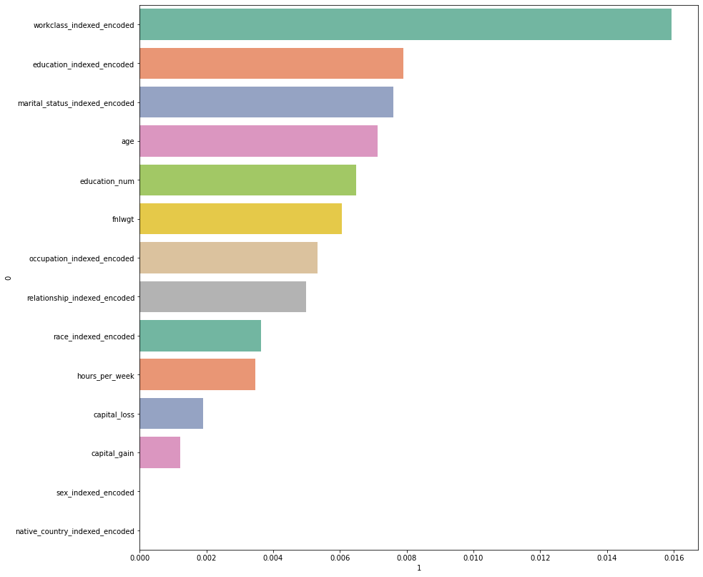
Learning Pipeline: Decision Tree
Workclass
Education
Marital Status
Age
Important Features
Education_Num
Final weight
Occupation
Which all of these are expected to be important when talking about one’s income

Slide 46
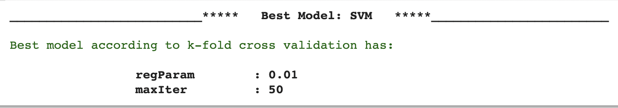
Learning Pipeline: SVM

Slide 47
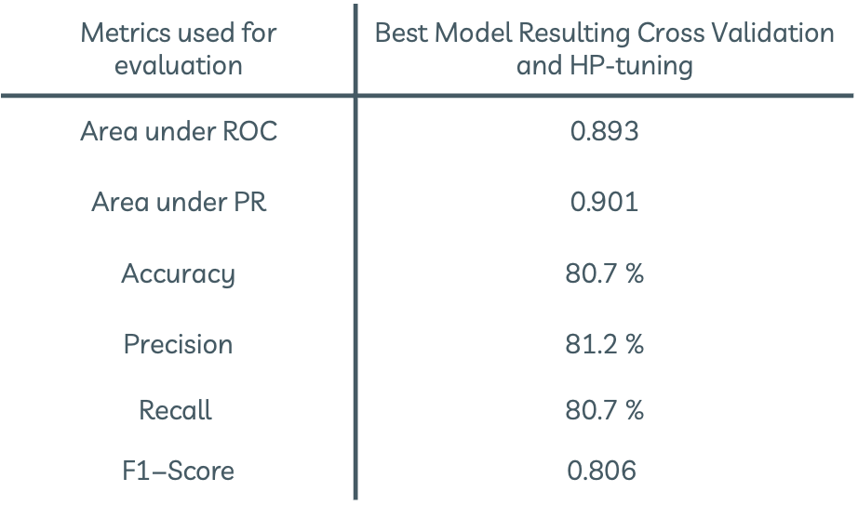
Learning Pipeline: SVM
Metrics used for evaluation | Best Model Resulting Cross Validation and HP-tuning
Area under ROC | 0.893
Area under PR | 0.901
Accuracy | 80.7 %
Precision | 81.2 %
$$\text{Recall}$$ | 80.7 %
$$\text{F}\text{1−}\text{Score}$$ | $$\text{0.806}$$

Slide 48
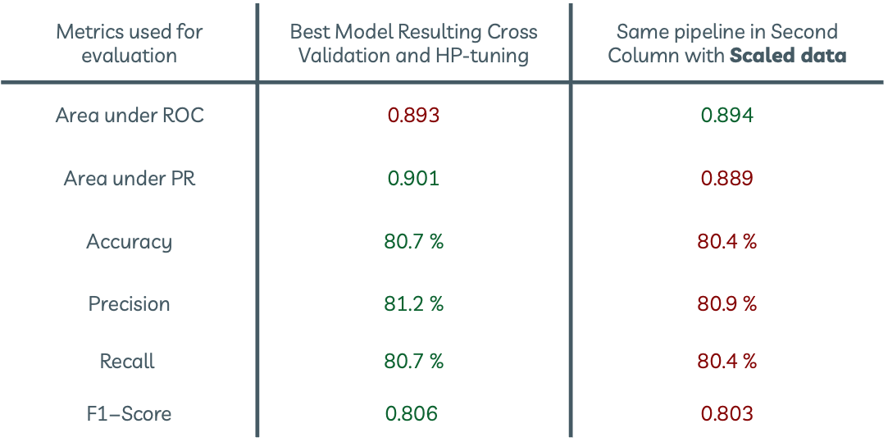
Learning Pipeline: SVM
Metrics used for evaluation | Best Model Resulting Cross Validation and HP-tuning | Same pipeline in Second Column with Scaled data
Area under ROC | 0.893 | 0.894
Area under PR | 0.901 | 0.889
Accuracy | 80.7 % | 80.4 %
Precision | 81.2 % | 80.9 %
$$\text{Recall}$$ | 80.7 % | 80.4 %
$$\text{F}\text{1−}\text{Score}$$ | $$\text{0.806}$$ | 0.803

Slide 49
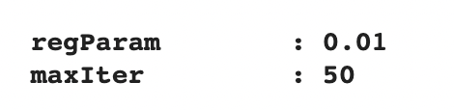
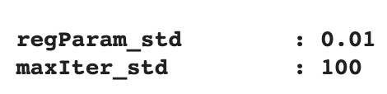
Learning Pipeline: SVM
I expected by applying the scaling the result would be better.
Why Not?
Without Scaling
With Scaling
Area under PR : 0.901
Area under PR : 0.889

Slide 50
Learning Pipeline: SVM
Why Not?
This time I have tried even many more values for Hypermeters with Scaling data

Slide 51
Learning Pipeline: SVM
Why Not?
This time I have tried even many more values for Hypermeters with Scaling data
There's no reason to believe that the new scaling is any better.
It’s true that the rescaled features will all vary in comparable units.
However, it is also possible that the original scaling happened to encode the data such that some important features had more prominence in the model.

Slide 52
Learning Pipeline: SVM
Why Not?
This time I have tried even many more values for Hypermeters with Scaling data
There's no reason to believe that the new scaling is any better.
It’s true that the rescaled features will all vary in comparable units.
However, it is also possible that the original scaling happened to encode the data such that some important features had more prominence in the model.
A feature in my dataset (fnlwgt) is happened to encode the data such that they become more important than others.

Slide 53
Learning Pipeline: SVM
Why Not?
This time I have tried even many more values for Hypermeters with Scaling data
There's no reason to believe that the new scaling is any better.
It’s true that the rescaled features will all vary in comparable units.
However, it is also possible that the original scaling happened to encode the data such that some important features had more prominence in the model.
A feature in my dataset (fnlwgt) is happened to encode the data such that they become more important than others.
The new scale results they all appear on similar scales and are all treated as equally important.

Slide 54
Learning Pipeline: SVM
Check generalization (overfitting)
Best Model
Training Set
Test Set
areaUnderROC:
0.896
areaUnderROC:
0.893
My model is not overfitted and it would be able to generalize well to the new data as like my test set

Slide 55
Learning Pipeline: Random Forest
I could not apply param_grid at one shot:
Failed all the time both on databricks and Google Colab
Create small Grids with different hyperparameters
And run every small Grid separately!
Even if fails, I won’t lose everything. Some of the
small grids were able to finish their job.
Successful grids will be documented separately.

Slide 56
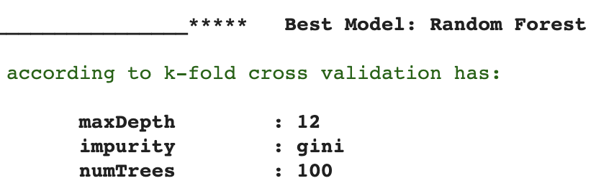
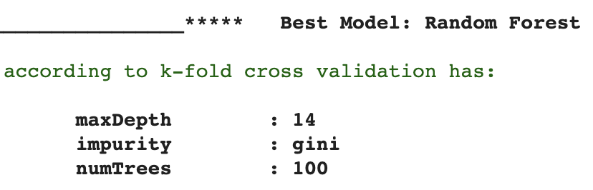
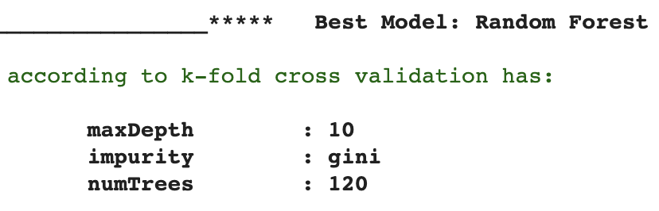
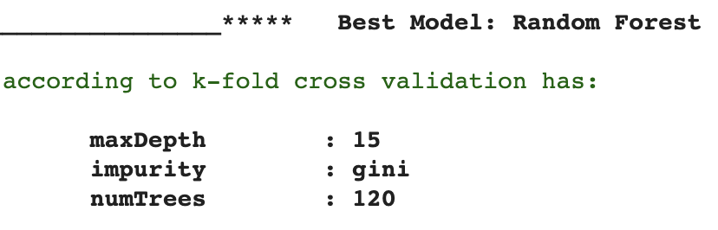
Learning Pipeline: Random Forest
Documented Result.
Complete summary of each small grid is in the notebook

Slide 57
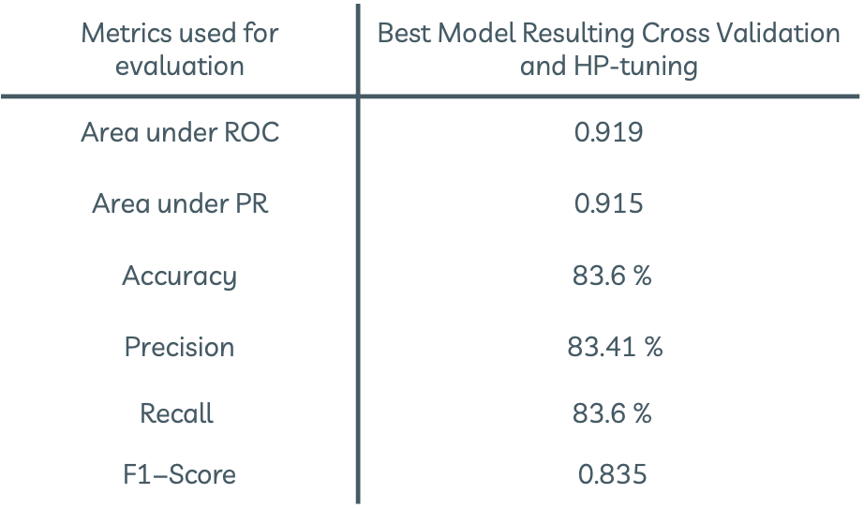
Learning Pipeline: Random Forest
Metrics used for evaluation | Best Model Resulting Cross Validation and HP-tuning
Area under ROC | 0.919
Area under PR | 0.915
Accuracy | 83.6 %
Precision | 83.41 %
$$\text{Recall}$$ | 83.6 %
$$\text{F}\text{1−}\text{Score}$$ | $\text{0.835}$

Slide 58
Learning Pipeline: Random Forest
Check generalization (overfitting)
Best Model
Training Set
Test Set
areaUnderROC:
0.912
areaUnderROC:
0.919
My model is not overfitted and it would be able to generalize well to the new data as like my test set

Slide 59
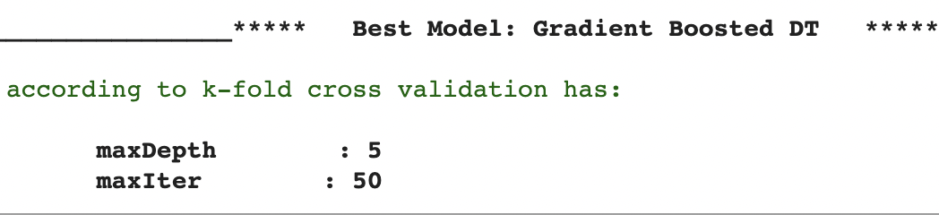
Learning Pipeline: Gradient Boosted Decision Tree
The same approach of small grids. Even with small grid
Failed many times after hours of running!
I could not train too many models to find the best one.
This is all I have for Gradient Boosted Decision Tree

Slide 60

Learning Pipeline: Gradient Boosted Decision Tree
Metrics used for evaluation | Best Model Resulting Cross Validation and HP-tuning
Area under ROC | 0.915
Area under PR | 0.921
Accuracy | 82.7 %
Precision | 82.9 %
$$\text{Recall}$$ | 82.7 %
$$\text{F}\text{1−}\text{Score}$$ | $\text{0.826}$

Slide 61
Learning Pipeline: Gradient Boosted Decision Tree
Check generalization (overfitting)
Best Model
Training Set
Test Set
areaUnderROC:
0.903
areaUnderROC:
0.915
My model is not overfitted and it would be able to generalize well to the new data as like my test set

Slide 62
Note: Without down-sampling
Same Pipeline has been applied to
Decision Tree & SVM
The result and comparison between all models are summarized in the next slide

Slide 63
Comparison: with/ without Down-sampling
 | AUC | AU-PR | Accuracy | PR | Recall | F1 Score
DT: Down-sampled data | 0.839 | 0.856 | 78.7% | 78.8% | 78.7% | 0.787
DT: No change on dataset | 0.810 | 0.618 | 83.9% | 83.2% | 83.9% | 0.834
SVM: Down-sampled data | 0.893 | 0.901 | 80.7% | 81.2% | 80.7% | 0.806
SVM: No change on dataset | 0.897 | 0.751 | 84.5% | 83.8% | 84.5% | 0.836

Slide 64
Best Model?
What is the best model?

Slide 65
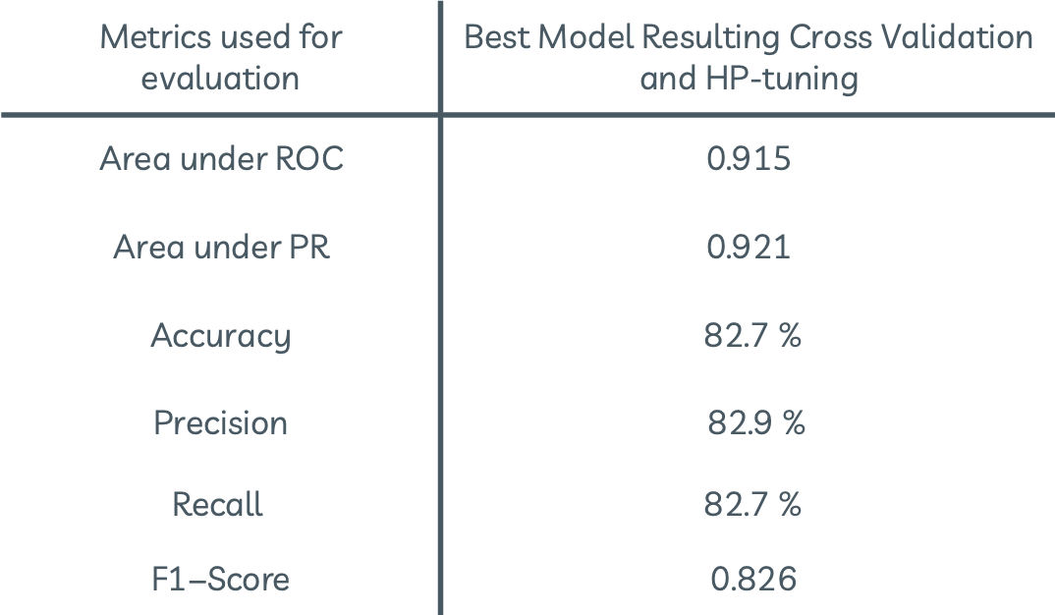
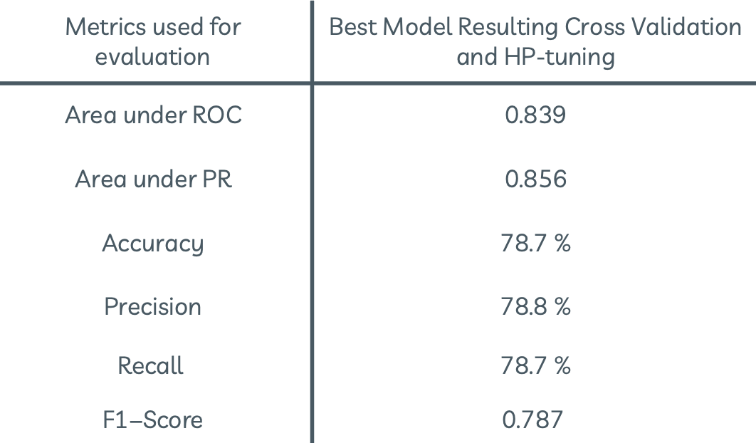
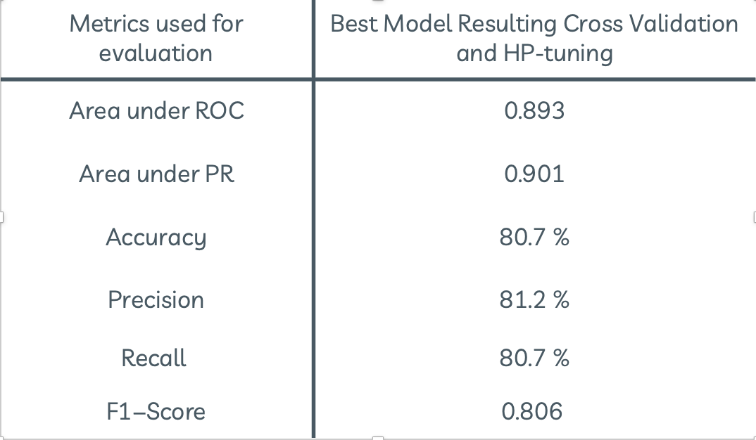
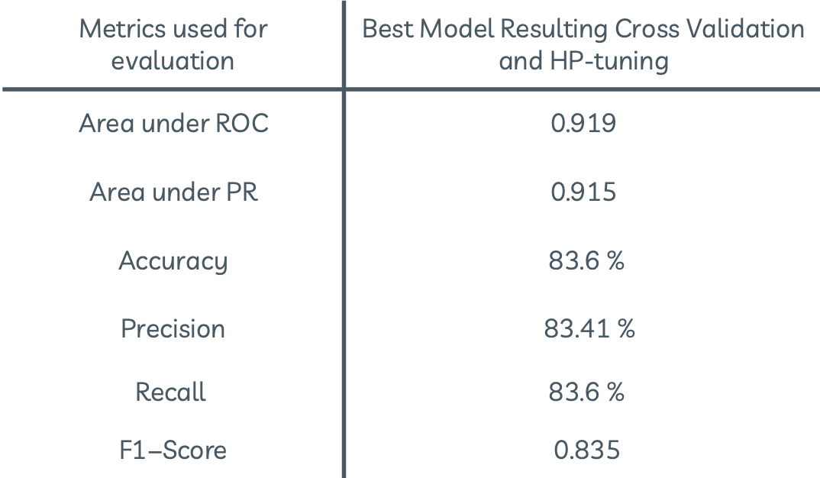
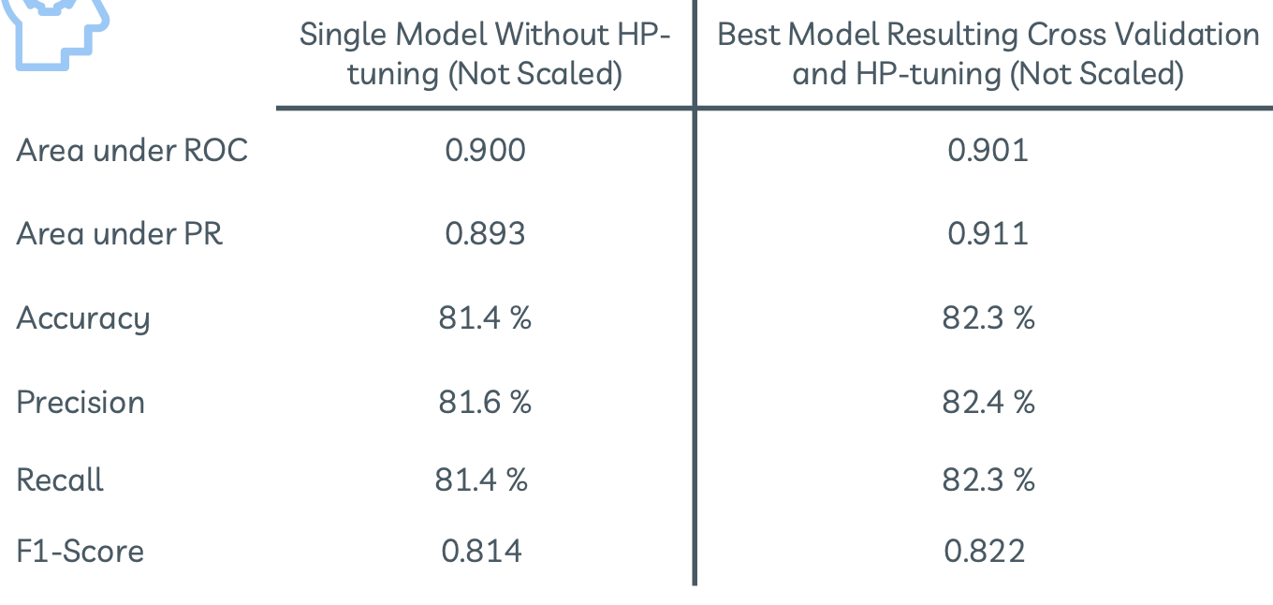
GBDT
Decision Tree
Random Forest
SVM
Logistic Regression

Slide 66
Best Method: Random Forest
Best Model
0.919
0.915
83.6%
82.9%
82.7%
AUC
AU-PR
Accuracy
Precision
Recall
Max-Depth: 15
Impurity: gini
NumTrees: 120

Slide 67
06
Conclusion
Outcome and future work

Slide 68
Conclusion
The results of gbtr are also good, but training takes much more time
Different methods have been compared
The best model was using Random Forest with:
Max-depth 15
Trees 120
Impurity gini
There could be a way to improve the performance. (future work)

Slide 69
Future Work
Handling Skewed data using different approaches like: Log Transform
Apply other methods: like Naïve bayes and compare the result.
Other strategy to balance the dataset like : SMOTE

Slide 70
Thanks!
teymoori.1947458@studenti.uniroma1.it
Big data computing Project
2020/21

Slide 71
Resources
The main resources are the course repositories, part of the codes are taken from the material notebooks.
https://github.com/gtolomei/big-data-computing
https://towardsdatascience.com/top-3-methods-for-handling-skewed-data-1334e0debf45
https://github.com/gtolomei/big-data-computing/blob/master/notebooks/Classification.ipynb
https://github.com/gtolomei/big-data-computing/blob/master/slides/10_Logistic_Regression.pdf
https://medium.com/@junwan01/oversampling-and-undersampling-with-pyspark-5dbc25cdf253
https://stackoverflow.com/questions/50363463/linearsvc-missing-in-apache-spark-2-1-non-linear-kernels-in-spark-2-2
https://stackoverflow.com/a/38781980
https://stackoverflow.com/a/63910523
https://spark.apache.org/docs/3.0.0-preview/mllib-decision-tree.html
And Many more…..

